Slide 1
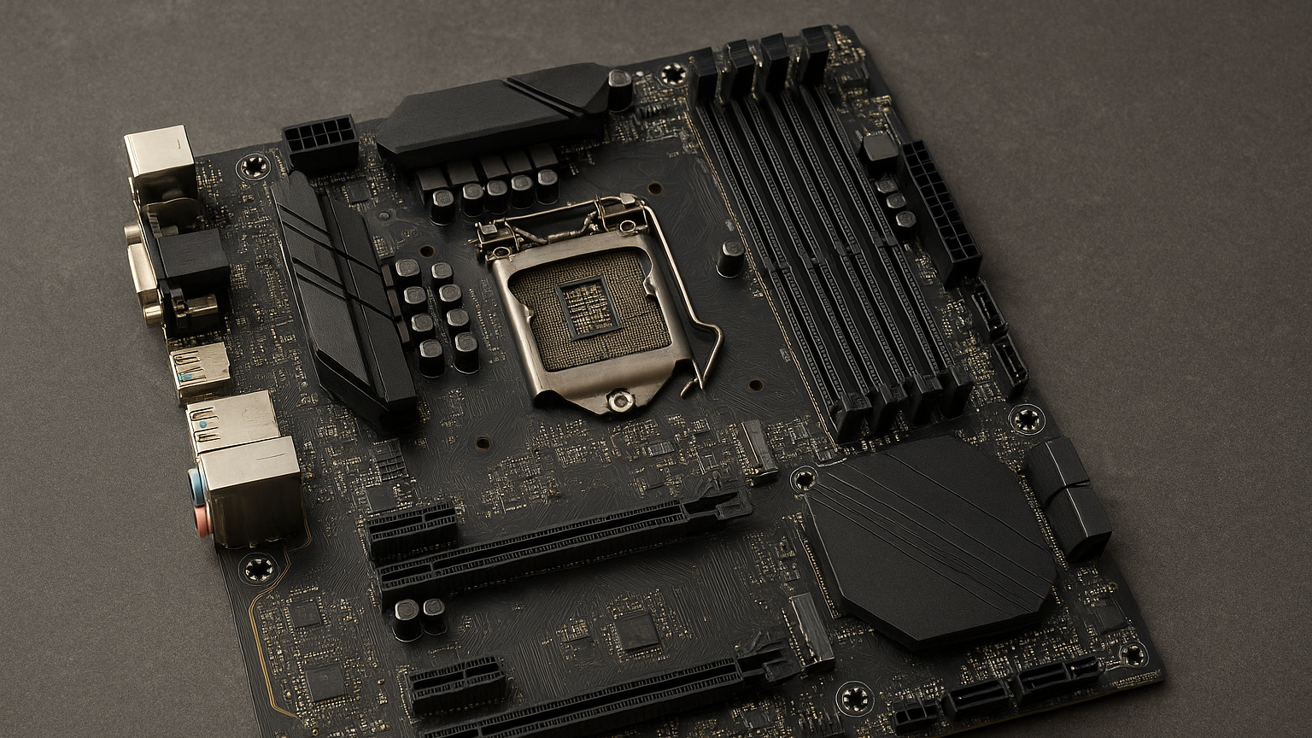
Introduction To Motherboard
The Backbone Of Computer Hardware

Slide 2
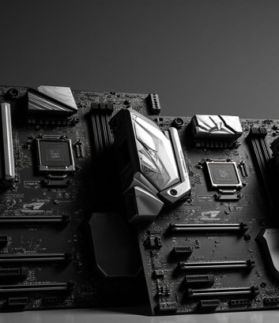
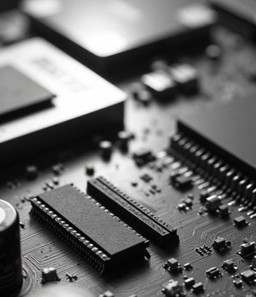
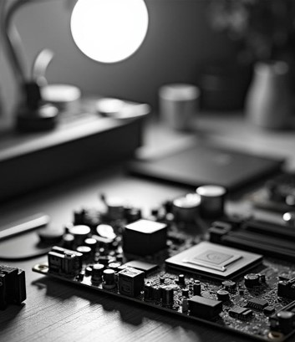
What is Motherboard?
The motherboard is the main circuit board of a computer that connects and allows communication between all hardware components (CPU, RAM, GPU, storage, etc.).
It acts as the central hub that connects the CPU, RAM, storage, and other hardware.
It’s often called the “heart” or “backbone” of the computer system

Slide 3
The History and Evolution of the Motherboard: A Timeline from the 1980s to Today
Early 1980s – The Beginning:
The first true motherboard appeared with the IBM Personal Computer (PC) in 1981. It was called the “planar board” and contained the CPU, memory, and other essential components.
Mid-1980s – Expansion Era:
As technology advanced, motherboard designs included more expansion slots to allow users to add features like sound cards, graphics cards, and network adapters.
1990s – Standardization:
The AT (Advanced Technology) and later ATX (Advanced Technology Extended) form factors were developed by Intel. The ATX motherboard, introduced in 1995, became the industry standard due to better power distribution and component layout.
2000s – Integration and Speed:
Motherboards began integrating more features directly onto the board — such as sound, video, and networking — reducing the need for separate expansion cards.
2010s–Present – Modern Era:
Modern motherboards support high-speed processors, DDR4/DDR5 RAM, M.2 SSDs, USB-C, and Wi-Fi 6, along with advanced RGB lighting and AI-based tuning for gaming and performance optimization.

Slide 4
Main Components of a Motherboard
CPU SOCKET
RAM SLOT
EXPANSION SLOT
STORAGE CONNECTION
POWER CONNECTOR

Slide 5
Types Of Motherboard
1.By Form Factor ( Shape/Size )
ATX – Full-sized, most features, expansion slots, best for gaming/workstations.
Micro-ATX – Smaller, fewer expansion slots, good for budget builds.
Mini-ITX – Very compact, limited slots, ideal for small PCs/HTPCs.

Slide 6
2. By CPU Compatibility
Intel Motherboard
LGA socket types ( LGA 1700 , LGA 1200, ETC
AMD Motherboard
AM4 , AM5 ETC

Slide 7
Function Of Motherboard
Connects All Components: Links CPU, RAM, GPU, and storage devices.
Power Distribution: Distributes power from the PSU to different parts.
Data Communication: Transfers data between CPU, memory, and peripherals.
Holds BIOS/UEFI: Stores firmware that starts the computer.
Expansion Support: Provides slots (PCIe, M.2) for graphics and other cards.

Slide 8
Working Principle of Motherboard
Power Supply
BIOS/UEFI
Chipset Control
CPU Processing
Memory RAM
Storage Device
Output Display

Slide 9
Factors to Consider When Choosing a Motherboard
CPU Compatibility – Check if it supports your processor’s brand and socket type.]
Form Factor (Size) – Choose between ATX, Micro-ATX, or Mini-ITX based on your case size.
RAM Support – Number of slots, DDR version (DDR4 or DDR5), and max capacity.
Expansion Slots – For graphics cards, sound cards, etc.
Connectivity – USB ports, Wi-Fi, Bluetooth, and M.2/SATA for storage.

Slide 10
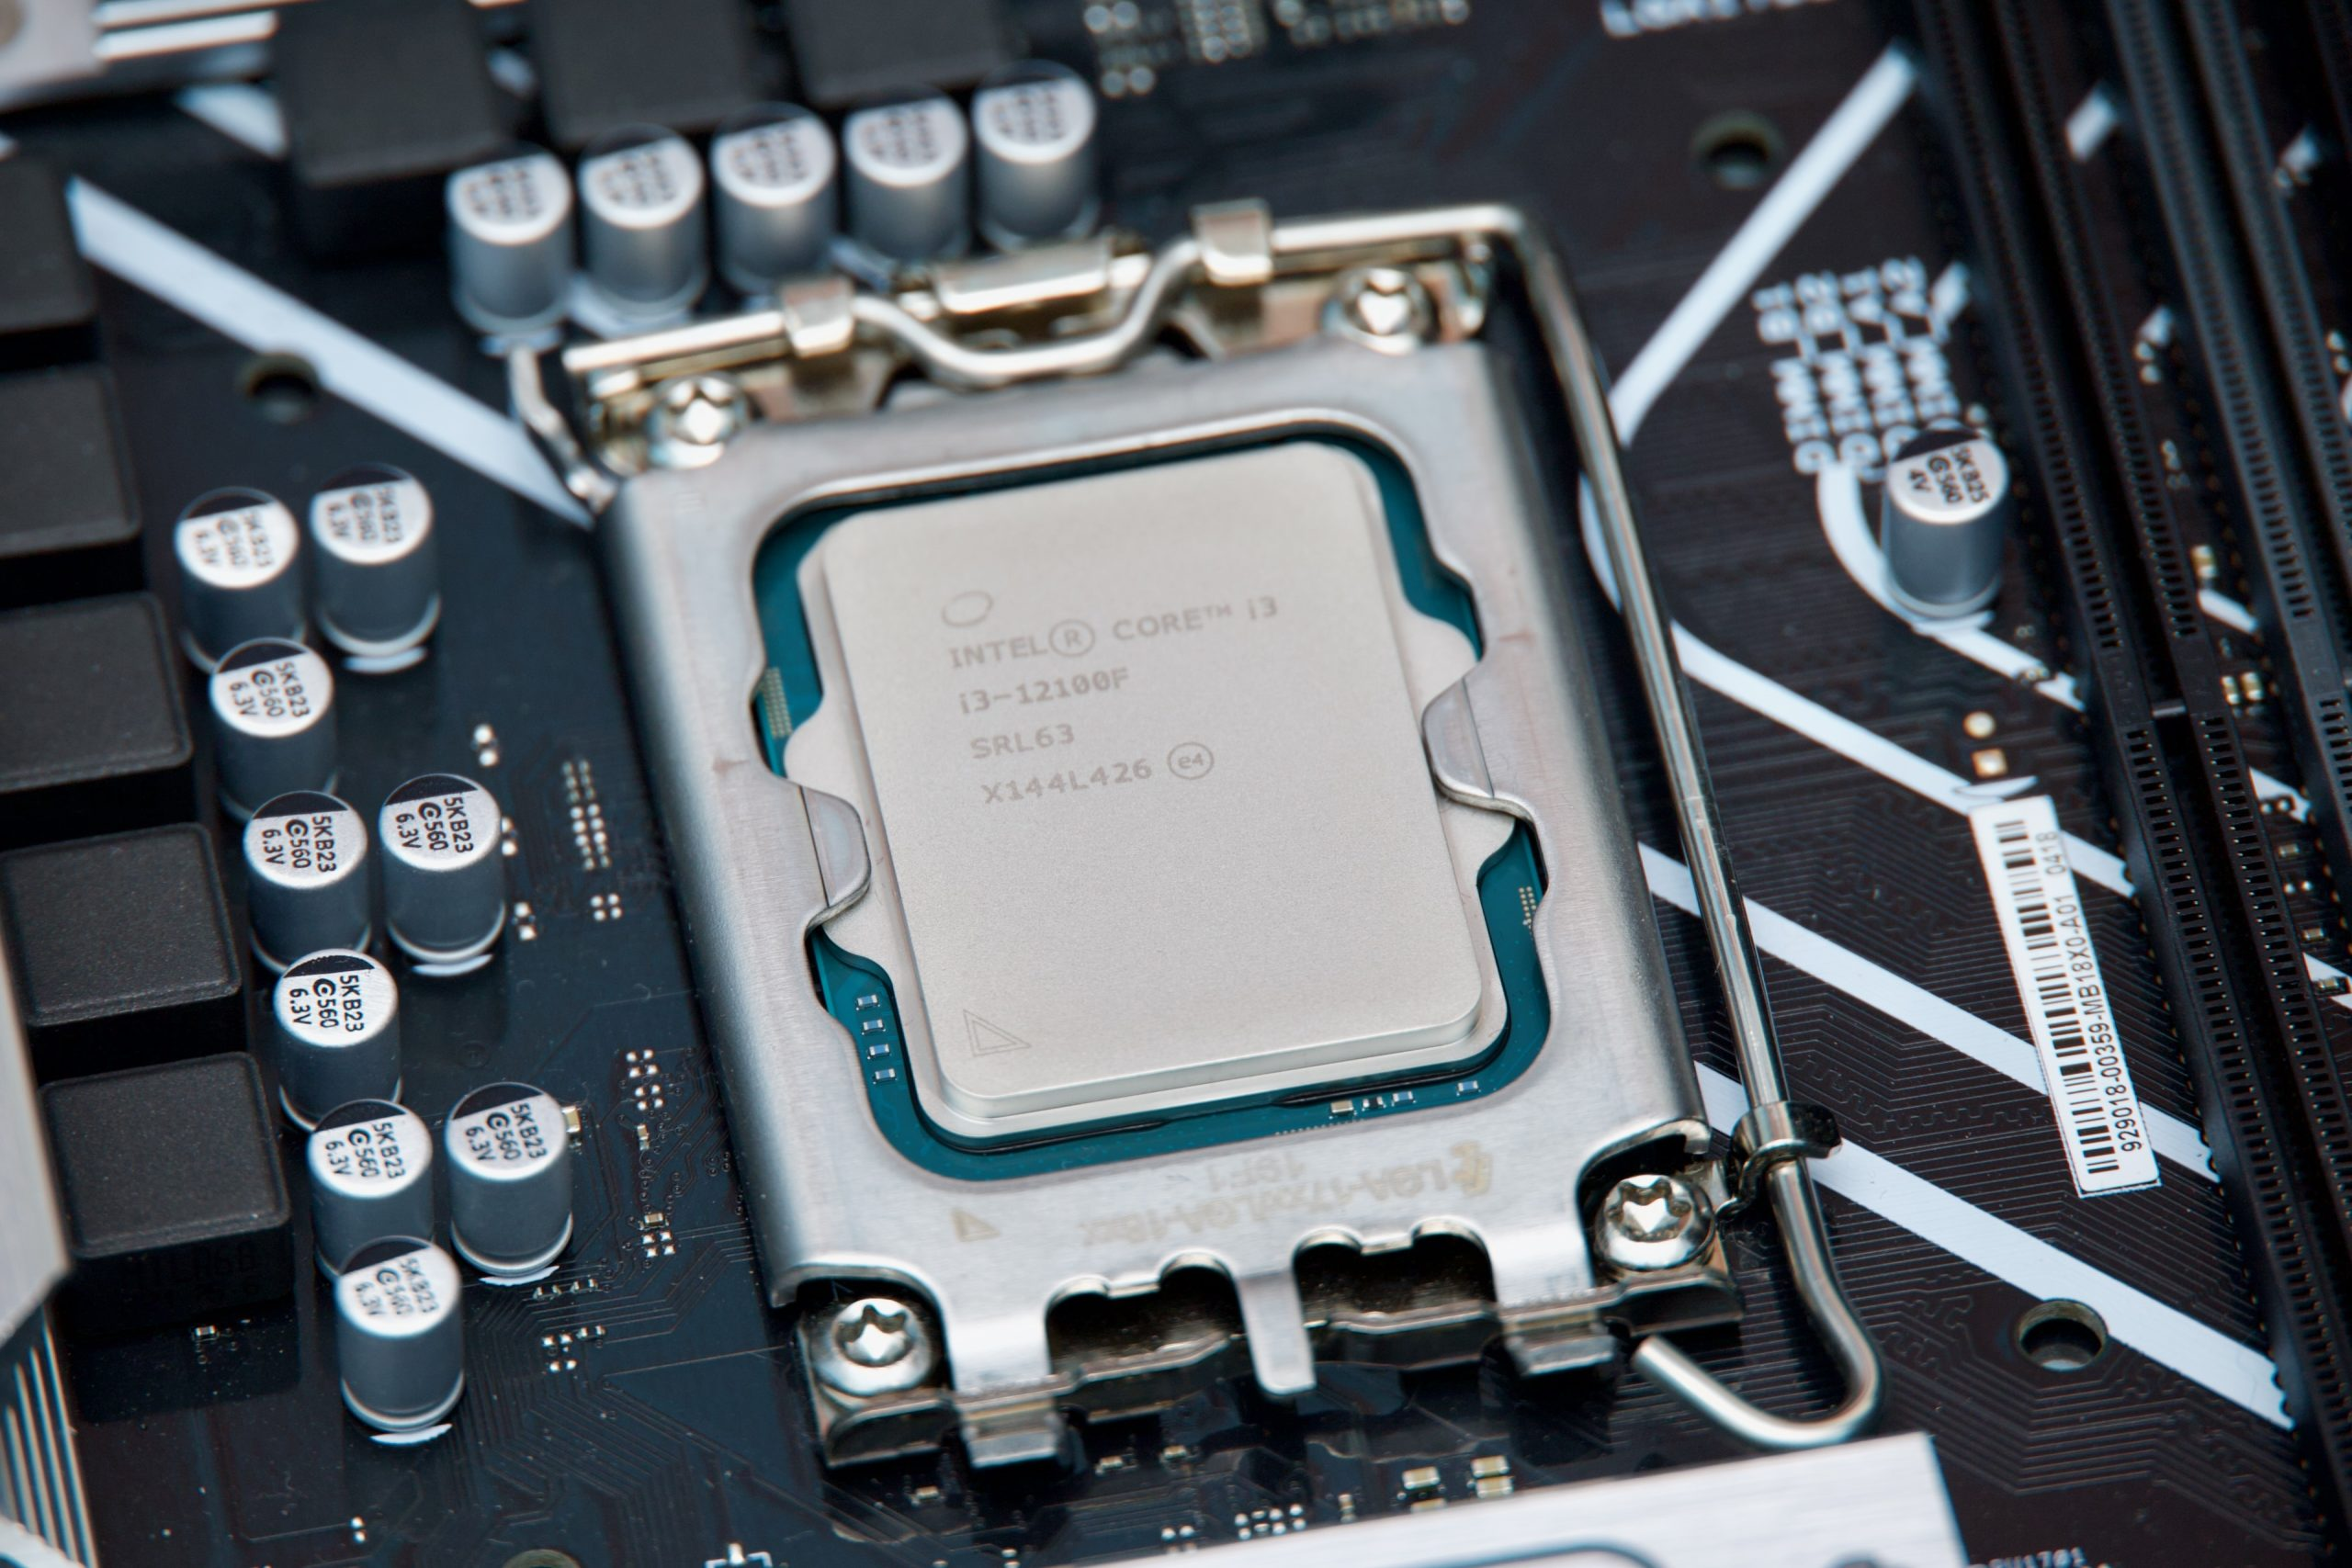
Intel Motherboard & AMD Motherboard
Strong single-core performance
Great for office work, productivity, and light gaming
Often includes latest connectivity features (like Thunderbolt, Wi-Fi 7)
Expensive compared to AMD for similar performance
Frequent socket changes — limited upgrade options
Higher power consumption on some models

Slide 11
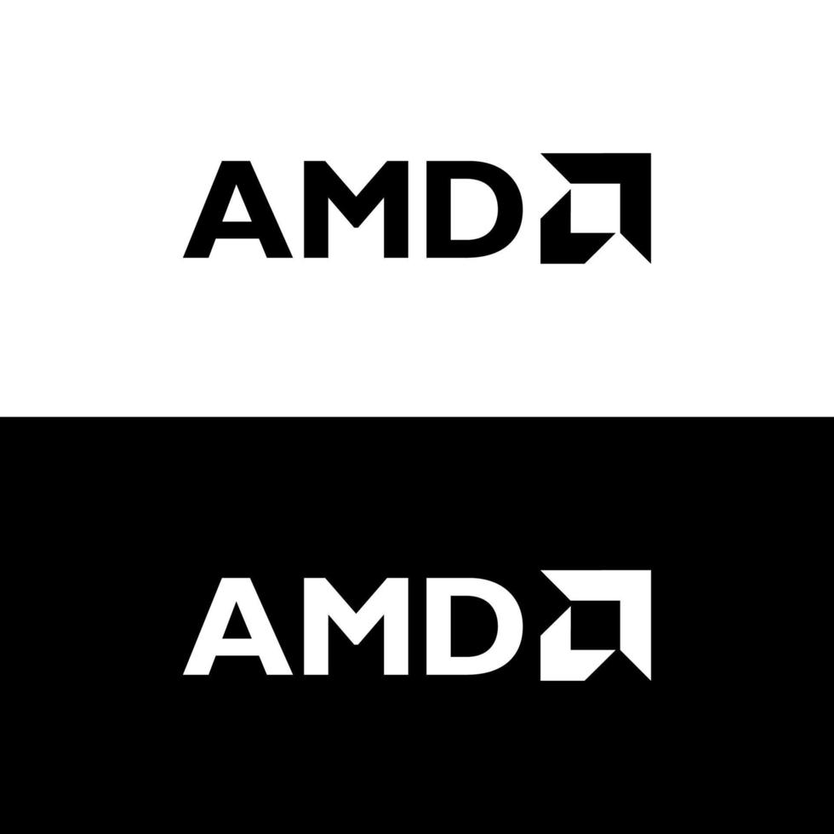
AMD Motherboard
Excellent gaming performance and multitasking
Better value for money
Long-term socket support (easy to upgrade CPU)
Efficient and cooler operation
Slightly lower single-core performance on some older models
Fewer high-end motherboard options in certain markets

Slide 12

Presented By:
Anish Giri (@azure.15_69)
Aabishkar Acharya (@abhi_motuu)
Aakarshan karki (@aaku0909_)
Prakat Baral (@prakat_baral)
Thank you for bearing with us

